Slide 1
In this section, we will discuss:
Difference between System Software and Application Software
Difference between Linux and Windows OS
Proxy Server

Slide 2
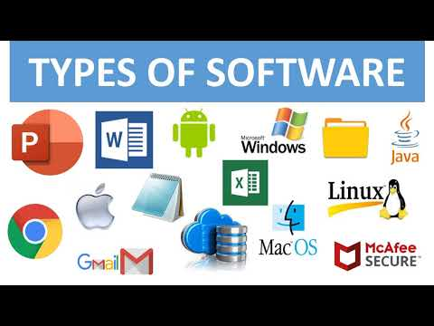
What is software?
Software is a set of instructions, data or programs used to operate computers and execute specific tasks.
It is the opposite of hardware, which describes the physical aspects of a computer.
It can be thought of as the variable part of a computer, while hardware is the invariable part.

Slide 3
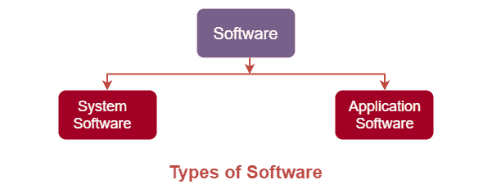
Types Of Software Program

Slide 4
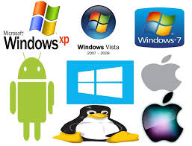
System Software
System Software can be designed as the software in such a way so that it can control and work with computer hardware. It acts as an interface between the device and the end user.
It also provides the platform for the running of other software.
Example: operating systems, antivirus software etc.

Slide 5
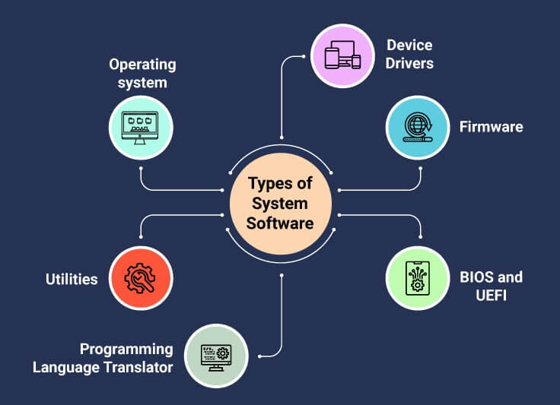
Types of system software
Operating system
Device Driver
Language processors

Slide 6
Features of System Software
System Software is closer to the system
Generally written in a low-level language
The system software is difficult to design and understand
Fast in speed
Less interactive
Smaller in size
Hard to manipulate

Slide 7
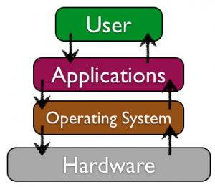
Application Software
Application Software is a program that does real work for the user. It is mostly created to perform a specific task for a user.
Application Software acts as a mediator between the end-user and System Software. It is also known as an application package.
This type of software is written using a high level language like C, Java, VB. Net , etc. Example: Word-processing, Spreadsheet, Database, etc.

Slide 8
Types of Application software
General Purpose Software E.g. MS word, Ms-Excel, Power Point
Customized Software E.g. railway reservation system, airline reservation system
Utilities software E.g. Antivirus, disk fragmented, memory tester, disk repair.

Slide 9
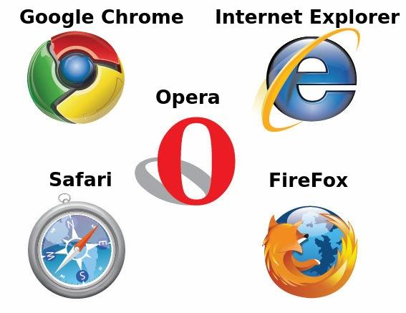
Features of Application software
An important feature of Application Software:
Perform more specialized tasks like word processing, spreadsheets, email, photo editing, etc.
It needs more storage space as it is bigger in size
Easy to design and more interactive for the user
Generally written in a high-level language

Slide 10
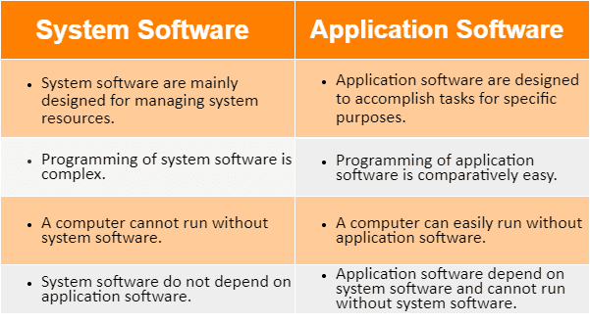

Slide 11
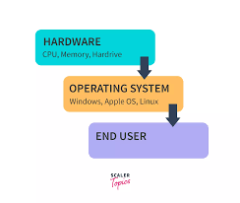
What is operating system?
An operating system is a program that controls the execution of application programs and acts as an interface between the user of a computer and the computer hardware.
A more common definition is that the operating system is the one program running at all times on the computer with all else being application programs.

Slide 12
Difference between linux and OS
Linux
Windows OS
Linux Is a open source operating system
Linux is free of cost
Monolithic kernel used
Linux is more efficient compared to windows
Provide more security than windows
While windows is licensed operating system
While windows is paid and costly
Micro kernel used
Less efficient compared to linux
While it provide less security than linux

Slide 13
Introduction to proxy servers
Monitoring and Filtering
1) Proxy servers allow us to do several kind of filtering such as:
2) Content Filtering
3) Filtering encrypted data
4) Bypass filters
5) Logging and eavesdropping

Slide 14
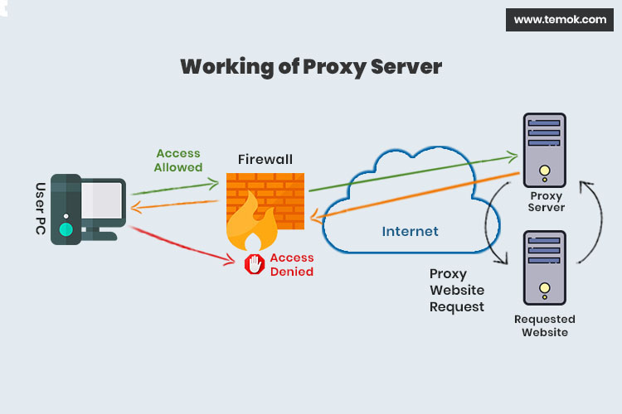

Slide 15
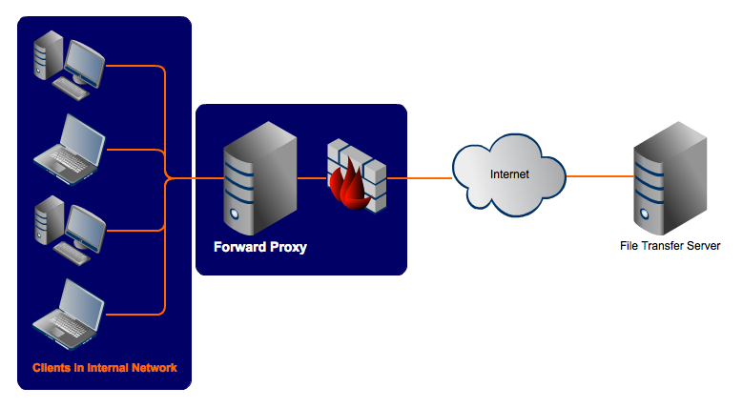
Types of Proxy server
Forward Proxy :
In this the client requests its internal network server to forward to the internet.

Slide 16
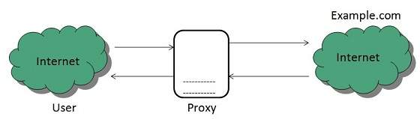
Open Proxy
Open Proxy
Open Proxies helps the clients to conceal their IP address while browsing the web.

Slide 17
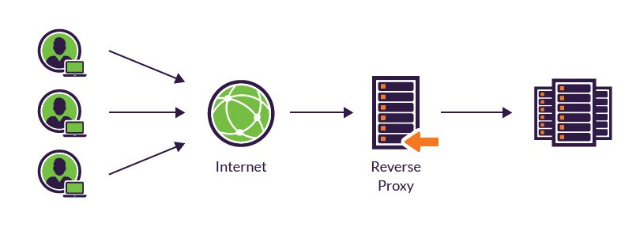
Reverse Proxy
In this the requests are forwarded to one or more proxy servers and the response from the proxy server is retrieved as if it came directly from the original Server.

Slide 18


